Slide 1

IDEATHON-2025
TITLE PAGE
IDEA Statement Title: Smart Health Monitoring and Emergency Alert System
Theme: Health and Well-being
Team Name : Idea Hunters
Team LEAD & Co-partner Name: Likhitha H K (Team lead ) & Kavya B M(co-partner)
USN: 1CG24CS086 & 1CG24CS068
College Name : Channabasaveshwara Institute of Technology ,Gubbi
Email ID: likhithahklikhi@gmail.com
Phone Numbers: 9902796101 , 8105240722

Slide 2
IDEA TITLE
IDEA /SOLUTION: Problem resolution:
To improve people’s overall health and well-being by 1)Lack of awareness:- Daily tips +personalized health plans
building small daily healthy habits using a smart and 2)No motivation:- Community challenges +rewards
motivational platform. 3)Stress and mental pressure:- Breathing exercises +
mental health chat support
4)Costly healthcare:- Free ai guidance + affordable health plans
The Wellness Buddy app provides: Poor routine Discipline:Smart reminders+habit tracking
Daily habit tracking – Water intake, sleep, steps, and meditation
Personalized health plans – Based on user goals like weight loss,
stress control, or fitness
Mental wellness support – Mood tracking and stress-relief exercises
AI Health Coach – Gives daily guidance like a personal trainer and Unique value proposition (UVP)
wellness guide A single affordable wellness app that combines physical
Community challenges – Group fitness and well-being challenges to health ,mental health ,and community motivation in one platform-
motivate users personalized for indians.
Health education – Short videos about diet, hygiene, mental health, 1)Support local language(English+kannada other Indian languages)
and fitness 2)Simple for students,working people ,and families
Rewards system – Earn points for healthy habits and redeem for 3) Focus on both mind and body
discounts or badges 4)Works offline for rural areas also
5)Rewards system keeps users motivated

Slide 3
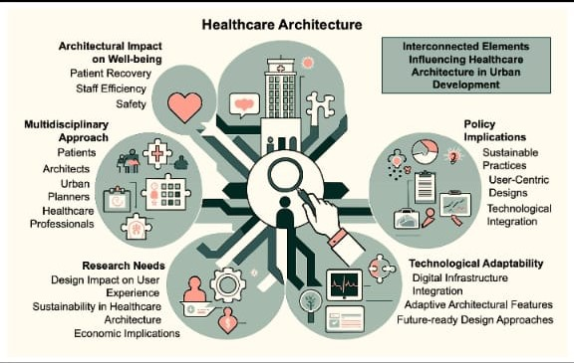
TECHNICAL APPROACH
Algorithm Development:
Algorithm Development (Step-wise):
1. Collect user data:- age, weight, height, health goals, daily habits.
2. Track daily activities:- steps, sleep, water intake, meals, mood.
3. Compare collected data with recommended targets.
4. Identify habits below target → send reminders or tips
5. Reward users for completed habits → points or badges.
Mobile Application Development (Step-wise):
1. User creates profile and sets health goals.
2. Dashboard displays daily activity, health score, and reminders
3. AI coach analyzes habits and provides personalized suggestions.
4. Users join community challenges to stay motivated
5. Notifications remind users to complete activities.
Encryption and Security (Step-wise):
Encrypt all sensitive data using AES-256.
Secure login using OAuth 2.0 / Firebase Authentication.
Use HTTPS for all communication between app and server.
Implement role-based access for authorized users.
Store backups in encrypted cloud storage.
Cloud Services (Step-wise):
1. Store user profiles, activity logs, and health data securely product status: ~65% complete,with core health tracking features ready and
2 .Run AI-based health analysis and tips on cloud servers. Security,cloud ,and wearable integration in prograss
3 .Synchronize data across multiple devices.
4 .Manage notifications and reminders through cloud messaging.
5 .Enable scalability as user base grows.

Slide 4
FEASIBILITY AND VIABILITY
Analysis of the feasibility of the idea: -
Technically possible with AI and wearables.
Moderate development cost, financially viable.
Easy adoption through user-friendly design.
Potential Challenges & Risks:-
Privacy concerns with sensitive health data.
Users may lose interest over time.
App bugs or device compatibility issues.
Strategies for Overcoming these Challenges:
Use encryption, comply with regulations.
Gamification and personalized reminders engage users.
Regular updates and responsive support system.

Slide 5
IMPACT AND BENEFITS
Potential impact on the target audience:-
Improves health awareness and daily habits
Increases access to healthcare support
Encourages preventive health practices
Reduces stress and mental health issues
Builds healthier lifestyle in communities
Promotes long-term well-being and productivity
Benefits of the solution (social, economic, environmental, etc.):-
Social Benefits:- Economic Benefits :-
1)Improves community health awareness 1) Reduce medical treatment costs
2)Encourages healthy lifestyle habits 2) increses productivity and efficiency
3)Reduces stress and mental issues 3)supports health-tech job creation
4)Builds supportive health networks 4) Lowers burden on hospitals
5)Increases health education access 5) prevents costly chronic diseases
Environmental benefits:-
1) Promotes clean and healthy living
2) Encourages eco-friendly health habits
3) Reduces medical waste generation
4) improves overall public hygiene

Slide 6
RESEARCH AND REFERENCES
Details / Links of the reference and research work:-
The details and links of the reference and research work include the studies, reports, and articles that support our health and well-being solution.
These references provide evidence of the feasibility, effectiveness, and social impact of digital health technologies like mobile apps, AI-based monitoring, and preventive healthcare tools. By referring to trusted sources, we ensure that our solution is reliable, innovative, and aligned with global health standards.
WHO Digital Health – https://www.who.int/health-topics/digital-health
NIH Study on Mobile Health Apps – https://www.ncbi.nlm.nih.gov/pmc/articles/PMC7074646/
McKinsey Telehealth Report – https://www.mckinsey.com/industries/healthcare
IEEE IoT Health Monitoring – https://ieeexplore.ieee.org
HIPAA Data Security Guidelines – https://www.hhs.gov/hipaa/index.html

Slide 7
CONCLUSION/IMPACT
Conclusion:
The smart Health Monitoring and Emergency Alert System is a reliable and user-friendly solution designed to improve
personal healthcare through real-time monitoring,preventive care,and AI-driven alerts.It impowers individuals to take control of their health while providing fast emergency support to save lives.
Impact:
Promotes preventive healthcare and early diagnosis
Reduce health risks through continuous monitoring
Provides life-saving emergency alerts in critical situations
Supports rural and elderly patients with easy access to health services
Strengthens healthcare efficiency and reduces hospital load
Encourages a healthier and safer society

